Slide 1


Blood Bank And Donation
Shafayet Nur
Lecturer
Department of Computer Science and Engineering
Port City International University.
Course Teacher
This proposal project is submitted as a partial fulfillment of the requirement for the Software Engineering Course (Sessional).

Slide 2

Team Members
Shaik Abdul Ahad
Raisul Islam Asad
CSE 029 07666
Batch: CSE 29 E A
CSE 029 07674
Batch: CSE 29 E A
Sugiris Tanchangya
Sharmin Akter
CSE 029 07659
Batch: CSE 29 E A
CSE 029 07680
Batch: CSE 29 E A

Slide 3
Overview
Introduction
Problem Statement
Features and Functionality
Motivation
Benefits of Proposed System
Aim and Objectives
Conclusion
System Limitations
References
System Architecture
Thank You
Flow Chart

Slide 4

Introduction
A web-based blood donation management system.
Built using HTML, CSS (Tailwind + DaisyUI), PHP, and MySQL. [3][4][6][7]
Facilitates connection between blood donors and recipients.
Responsive web application accessible across all devices.
Streamlines the blood donation process through digital automation.

Slide 5

Difficulty in finding blood donors during emergencies.
Lack of centralized system for blood donor information.
Time-consuming manual process for donor-recipient matching.
Limited accessibility to blood donor information.
Inefficient communication between donors and recipients.
[1][2]
Problem Statement

Slide 6

Motivation
Save lives through quick access to blood donors.
Bridge the communication gap between donors and recipients.
Create awareness about blood donation.
Create a user-friendly platform for blood donation.
Promote social responsibility.
Modernize the blood donation process through technology.

Slide 7



Aim and Objectives
PRIMARY AIM
OBJECTIVES
Create a user-friendly donor registration system.
Implement efficient donor search functionality.
Develop a responsive web interface.
Establish a secure database for donor information.
Provide educational content about blood donation.
Enable quick access to donor information in emergencies.
To develop a comprehensive web-based blood bank management system that efficiently connects blood donors with recipients.

Slide 8


Manual donor search process.
1
5
Lack of real-time donor information.
Limited donor database accessibility.
2
Limited geographical reach.
6
System Limitations
Time-consuming donor verification.
3
Inefficient record keeping.
7
Delayed response in emergencies.
4
No centralized management system.
8
[2]

Slide 9
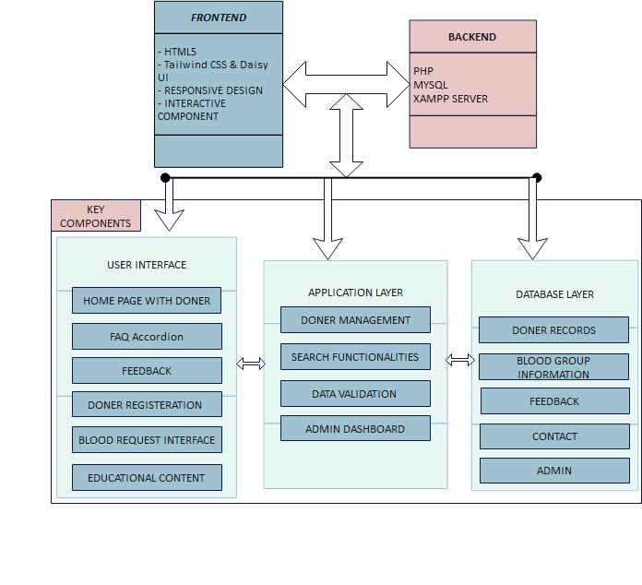
System Architecture

Slide 10
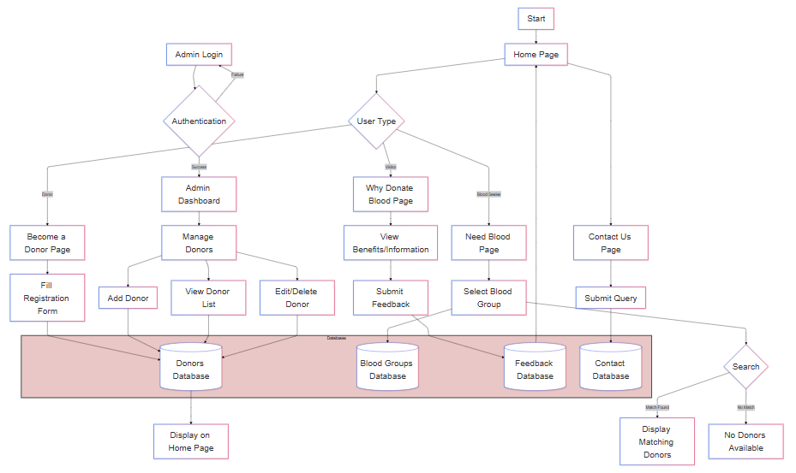
Flow Chart

Slide 11
Functionality
User Interface
Donor registration
Blood group search
Admin dashboard
Contact system
Feedback management
Features and Functionality
Responsive design
Interactive carousel
Donor information cards
Educational accordions
User feedback display
[3][4][5][6][7]

Slide 12


Benefits of Proposed System
For Recipients
Quick access to donor information
Real-time donor availability
Easy search functionality
Direct contact with donors
Emergency response capability
For Donors
Simple registration process
Profile management
Social contribution
Educational resources
Community engagement
For Administration
Centralized management
Efficient donor tracking
Data analysis capabilities
Easy record maintenance
System scalability

Slide 13

Modern solution for blood donation management.
Efficiently connects donors with recipients.
Reduces emergency response time.
Promotes blood donation awareness.
Contributes to saving lives.
Scalable and maintainable system.
Positive social impact.
Conclusion

Slide 14


References
[1]
World Health Organization. (2021). Global status report on blood safety and availability. Retrieved from WHO Website
[2]
Hossain, M. M., & Hossain, S. M. (2019). An Overview of Blood Bank Management Systems. International Journal of Computer Applications, 182(8), 1-6. doi:10.5120/ijca2019918711
[3]
PHP Documentation. (2023). PHP: Hypertext Preprocessor. Retrieved from PHP.net
[4]
MySQL Documentation. (2023). MySQL Reference Manual. Retrieved from MySQL.com
[5]
W3Schools. (2023). HTML, CSS, JavaScript Tutorials. Retrieved from W3Schools
[6]
Tailwind CSS. (2023). Tailwind CSS Documentation. Retrieved from Tailwind UI
[7]
daisyUI. (2023). daisyUI Components. Retrieved from daisyUI

Slide 15
Thank you

